Slide 1


Department of Computer Science and Engineering
CS191P11 –IOT
IOT BASED SMART CAR PARKING
SYSTEM
RAGUL S-230701253
AKASH N-230701019

Slide 2
ABSTRACT
The rapid urbanization and increase in vehicle population have led to significant challenges in urban parking management, including traffic congestion, fuel wastage, and time consumption. To address these issues, this project proposes an IoT-based Smart Car Parking System that utilizes modern technologies such as sensors, microcontrollers, and wireless communication to automate and optimize parking space usage. The system employs ultrasonic or infrared sensors to detect the availability of parking slots and updates the real-time status to a centralized cloud platform accessible via a mobile application or web interface. Drivers can view the availability of slots remotely and reserve them in advance, thereby minimizing search time and reducing traffic congestion. Additionally, the system supports features such as automated entry and exit using RFID or license plate recognition, digital payment integration, and data analytics for efficient parking space management. This smart solution enhances user convenience, promotes energy efficiency, and contributes to the development of smart cities.

Slide 3
Introduction
As cities grow and the number of vehicles increases, finding available parking spaces has become a daily challenge for drivers. Traditional parking systems are often inefficient, causing traffic jams, time delays, and unnecessary fuel consumption. To solve these problems, smart technology is needed.
IoT-Based Smart Car Parking System uses sensors, microcontrollers, and the internet to manage parking spaces in real time. The system can detect whether a parking slot is free or occupied and share this information through a mobile app or website. Drivers can easily find, reserve, and pay for parking without wasting time searching for a spot.
This smart system not only improves the parking experience for drivers but also helps reduce traffic congestion and pollution. It is a step forward in building smarter, more efficient cities.

Slide 4
Problem Statement
In urban areas, the increasing number of vehicles has made parking a major issue. Drivers often waste time and fuel searching for available spots, leading to traffic congestion, pollution, and frustration. Traditional parking systems lack real-time monitoring and guidance. There is a clear need for an IoT-based smart car parking system that uses sensors and wireless communication to detect slot availability and display it via web and LCD interfaces, making parking faster easier, and more efficient

Slide 5
Proposed Work
.
Detection and Monitoring: Each parking slot will be equipped with an IR sensor that detects whether a vehicle is present. These sensors will be connected to a microcontroller (Arduino or ESP32), which processes the sensor data. The system will continuously monitor the status of all parking slots to ensure accurate, up-to-date information.
Real-Time Data Transmission: The ESP32, with its built-in Wi-Fi capability, will send real-time data about the occupancy status of each slot to a central server or cloud-based web application. Additionally, an LCD display installed at the parking lot entrance will show the number of available slots, allowing drivers to make informed decisions quickly.
User Access and Interface: A web-based application will be developed to let users check parking availability remotely before arriving. The interface will display current slot status in real time and can be accessed via mobile or desktop devices. This helps reduce traffic congestion, waiting time, and fuel consumption by guiding users directly to free slots.

Slide 6
Implementation
Sensor Integration: IR sensors are installed in each parking slot to detect whether a vehicle is present or not.
ESP32 Processing: Each IR sensor is connected to an ESP32, which reads the input signals and determines the status (occupied or vacant) of each slot.
Data Transmission via ESP32: The Arduino sends the sensor data to the ESP32, which transmits real-time slot status to a web server over Wi-Fi.
Display System: A 16x2 LCD display is placed at the parking entrance to show the number of available slots based on live data from the ESP32.
Web Application Interface: A web-based app is developed to display current parking availability, allowing users to check and plan their parking before reaching the location.

Slide 7
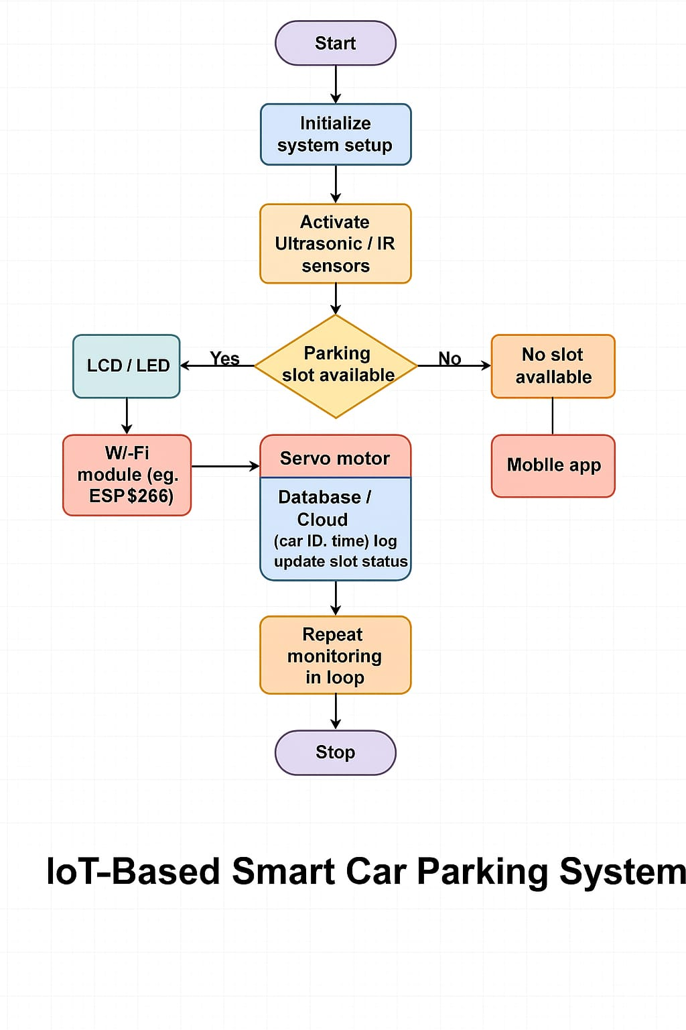
Architecture

Slide 8
system Requirements
IR sensor
ESP32
Jumper Wires
LCD Display
Breadboard
Power Supply
Arduino IDE
Web Browser

Slide 9
Advantages of the proposed system
Provides real-time parking slot availability.
Reduces time and fuel spent searching for parking.
Minimizes traffic congestion in and around parking areas.
Allows remote monitoring through a web or mobile app.
Improves parking space utilization and management.
.

Slide 10
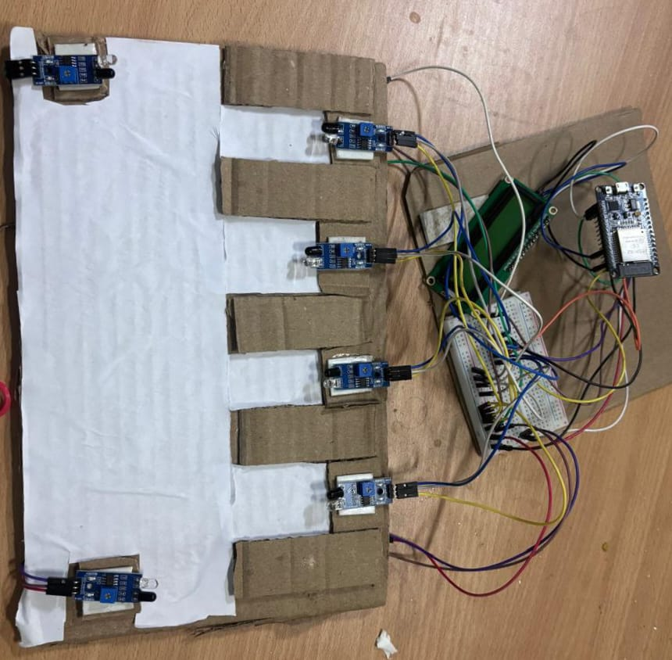
Smart Car Parking

Slide 11
Conclusion
The proposed IoT-Based Smart Car Parking System effectively addresses the challenges of traditional parking by offering real-time monitoring, remote access, and efficient space utilization. By using components like IR or ultrasonic sensors, Arduino, ESP32, and a web interface, the system enables users to quickly find available parking slots, reducing time, traffic congestion, and fuel usage. This smart solution enhances convenience for users and contributes to the development of smart and sustainable urban infrastructure.

Slide 12
References
[1]. Joni Welman Simatupang,yosep Salmen Alfarizi “Smart Parking System with IoT-Enabled using NodeMCU for Car Reservation in Public Areas”,IEEE conference
[2] Sugan Gupta,piyush Agarwal,Garima Sharma “PARKIT: An Android-based Real Time Smart Parking System using IoT”, International Conference
[3] Yugesh Kc;Chang Soon Kang “A connected Car Based Parking Location Service System (IoTals) 2019
[4] StephaneCedricKoumetioTekoubou, HassanSilkan“Improving Parking Availabilty Prediction in Smart Cities with Iot and Ensemble based model, Journal paper 2022

Slide 13
Thank You

